Slide 1

CHALLENGES TO INTRODUCE E-SUPPLY CHAIN MANAGEMENT PROCESS FOR PHARMACEUTICAL COMPANIES IN BANGLADESH
Author: Eusuf Hassan IVGM194255
Supervisor: Alexander Horst Norta

Slide 2
Agenda
Introduction
Existing Process
Research Question
Narrative
Methodology
Outcomes
Challenges
Conclusion
Q & A

Slide 3

Introduction
Emerging generic drug hub in the region
Nearly self-sufficient; 97% demand met by local production
Total market size approx. US $2 billion (2015) & Predicted US $6 billion by year 2025.
Registered pharmaceutical companies: 257; functional around 150
All the top 10 companies are local, and they have approx. 70% market share
Leading companies have major approvals (US FDA, EU GMP, UK MHRA, TGA Australia, ANVISA Brazil etc.)

Slide 4
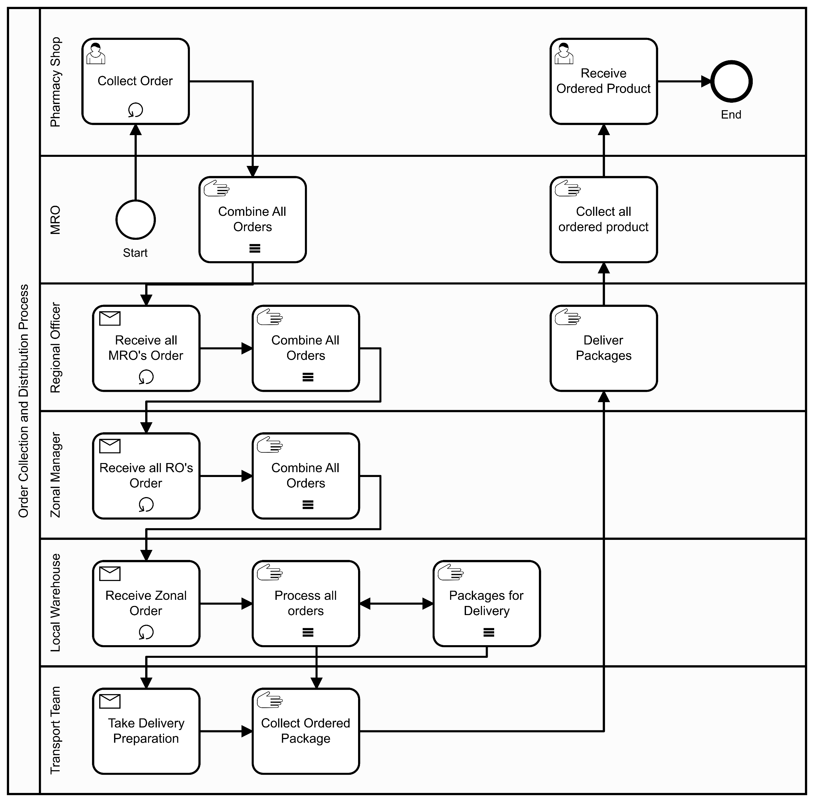
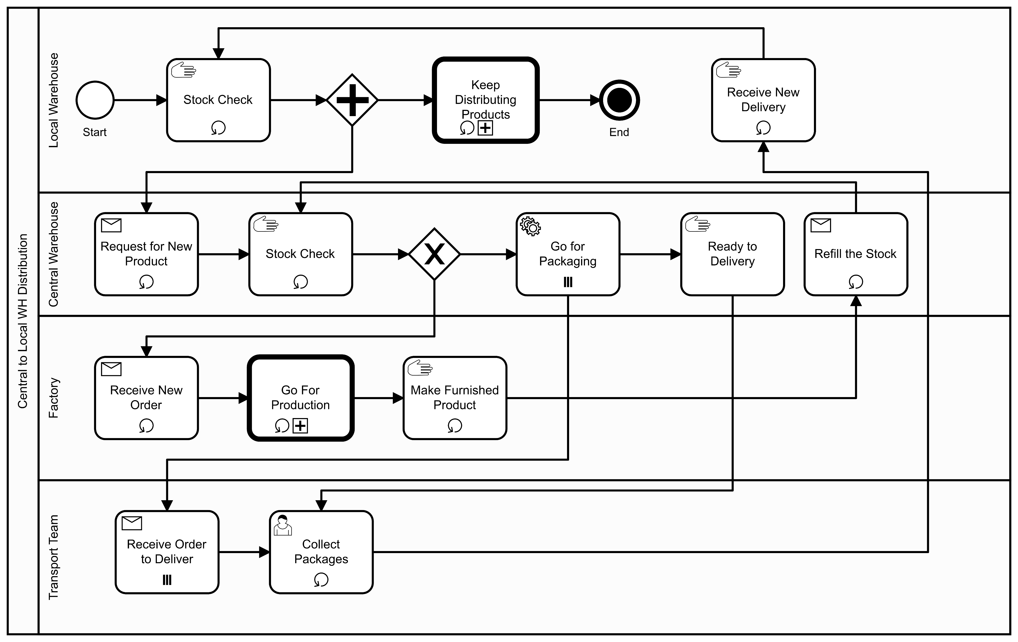
Existing Process

Slide 5
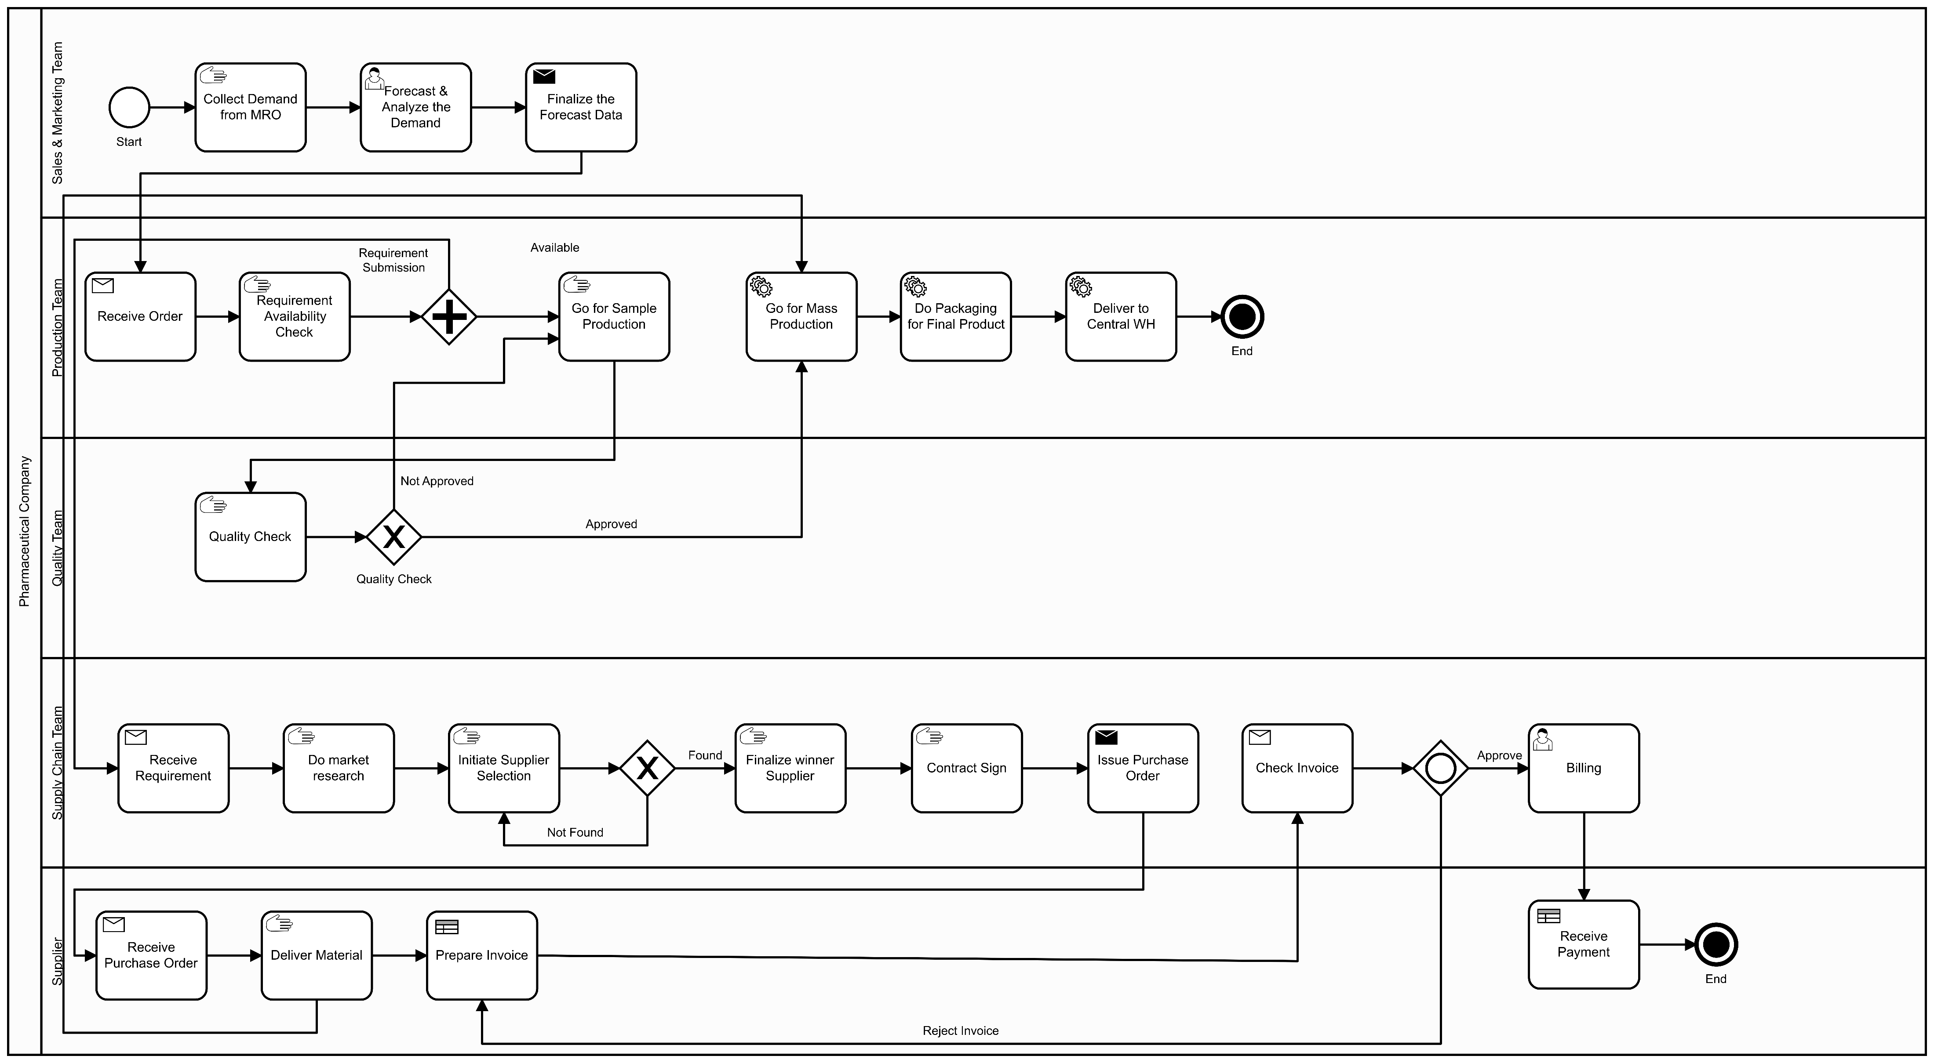
Existing Process

Slide 6
Research Question
How challenging is it to introduce an E-supply chain management system for pharmaceutical companies in Bangladesh?
02. How can the feasibility and the parameter of measuring benefits of integrated E-SCM system for pharmaceutical companies be determined?
- Ways of process transformation
- KPI of effective E-SCM System
- KPI of efficient E-SCM System
03. How can integrated E-SCM influence the actions of stakeholders of the pharmaceutical supply chain system?
- Stakeholder/s
- Challenges for Stakeholder/s
- Value addition for Stakeholder/s
01. How efficient is the current pharmaceutical supply chain process?
- Existing Process
- Unwanted Situation/s
- Suitable Solution/s

Slide 7

Narrative
D. A. Mazumdar and A. H. Helmi, “Digital Bangladesh – Vision 2021: What is the Digital Bangladesh Concept?,” South Asian Research Journal of Engineering and Technology, vol. 2, no. 1, February 2020.
R. Hoque, F. A. Mazmum and Y. Bao, “e-Health in Bangladesh: Current Status, Challenges, and Future Direction,” The International Technology Management Review, vol. 4, no. 2, pp. 87-96, June 2014.
S. M. Ahmed, M. A. Hossain, A. M. Raja Chowdhury and A. U. Bhuiya , “The health workforce crisis in Bangladesh: shortage, inappropriate skill-mix and inequitable distribution,” Human Resources for Health, vol. 9, no. 3, 2011.
A. Mohiuddin, “An A-Z Pharmaceutical Industry: Bangladesh Perspective,” Asian Journal of Research in Pharmaceutical Sciences., vol. 9, no. 1, March 2019.
B. D. G. o. H. Service, “Bangladesh eHealth Standards & Interoperability Framework,” Bangladesh Director General of Health Service, Dhaka, Bangladesh, 2012
S. Islam, A. Rahman and A. Al-Mahmood, “Bangladesh Pharmaceutical Industry: Perspective and the Prospects,” Bangladesh Journal of Medical Science, vol. 17, pp. 519-525, 04 October 2018

Slide 8
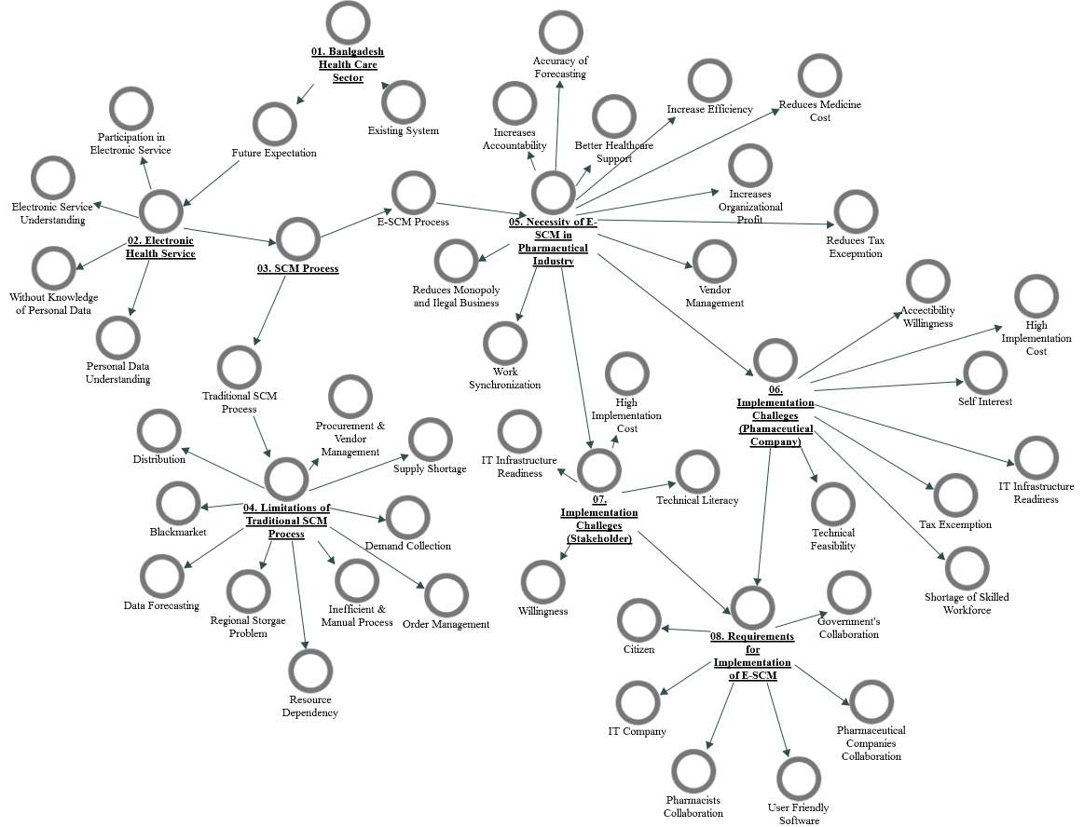
Methodology
Single Case Study
The existing manual system do not analyse supply chain management practices in an integrated and detailed manner. This reduces the overall efficiency, organizational profit. At the same time, it increases the consumer's expenditure and dependency on government agencies.
Data Analysis
Bangladesh
Pharmaceutical Industry
Supply Chain Process
Translated from Bengali to English
YouTube
NVivo
Data Collection
Category | Quantity
Manager | 3
Medical Representative officer | 3
Specialist & Coordinator | 2
IT Professional | 2
Semi-Structured Interview questions
10 interviewees interview conducted

Slide 9
Outcomes
E-Health
E-SCM
Implementation of E-SCM
Pharmaceutical Companies:
IT Infrastructure Readiness
High Implementation Cost
Skilled workforce
Willingness
Tax Exemption
Traditional SCM
Necessity of E-SCM:
1) Forecast Accuracy
2) Reduce Monopolistic Business
3) Work Synchronization
4) Increase Efficiency
5) Easier Order Management
6) Reduce Medicine Cost
7) Increase Accountability
8) Reduce Tax Exemption
Stakeholders:
IT Infrastructure Readiness
High Implementation Cost
Technical Literacy
Willingness
Limitation:
1) Black-market
2) Data Forecasting
3) Demand Collection
4) Distribution
6) Order Management
7) Procurement & Vendor Management
8) Regional Storage Problem
9) Supply Shortage.
Government’s Initiative
IT Infra Readiness
User Friendly Software
Citizen’s Acceptability
Requirements for Implementation

Slide 10

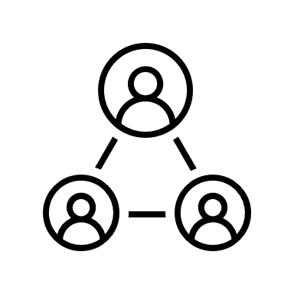


Challenges
High Implementation Cost
Shortage of Skilled Workforce
IT Infrastructure Readiness
Willingness to Adopt

Slide 11
Conclusion
How efficient is the current pharmaceutical supply chain process?
There are several problems like black market, data forecasting, demand collection, distribution, order management in the existing SCM process and the specific solutions include traditional way. Also, taking legal actions for selling medicines in the black market by the government agencies. However, these manual solutions do not completely ensure the smooth transportation and distribution of medicines. So the effective solution is implementing the e-SCM system in the Bangladeshi Pharmaceutical industry.
How can the feasibility and the parameter of measuring benefits of integrated E-SCM system for pharmaceutical companies be determined?
Its purpose of implementing E-SCM is not to hamper or create obstacles for the companies, patients, or other involved parties. Its main purpose is to bring transparency in the system, reduce the bureaucracy & dependencies, improve citizens' life, control the black market and increase the tax. An analysis of the pharmaceutical company's performance concerning the introduction of the E-SCM would be conducted after the implementation of the E-SCM system.
How can integrated E-SCM influence the actions of stakeholders of the pharmaceutical supply chain system?
The end-user experience is essential in project success. Thus, users’ feedback should be regularly gathered, and the system should be adjusted accordingly or improve continuously to make the system as user-centric as possible. It is also suggested that success must be measured in terms of users' awareness.

Slide 12
Thank You

Slide 13
Question & Answer
When answering the research question “What could be the main parameters of an effective supply chain system for pharmaceutical companies in terms of an integrated E-SCM system?” the author has come up with the answers “Increase efficiency”, “Reduce Operational Cost”. These answers are applicable to any industry in any country. Even if more concrete answers were not derived from the interviews, can the author give his own ideas on how to measure the effectiveness of pharmaceutical supply chain and provide a list of specific parameters?
In chapter 4.3 the author claims that one of the benefits that E-SCM can bring to the stakeholders according to the conducted interviews is registering new pharmaceutical products. Please explain how in the context of Bangladesh registration of pharmaceutical products is connected to supply chain. Also, please specify which interviewee mentioned that, the page and paragraph of the interview.
Please justify why the case of Bangladesh was picked except for the reason the author supposedly knows it well. What makes the pharmaceutical industry and the supply chain there stand out among plenty of other countries that produce primarily generic medications?

Slide 14
Answer 01
Q1: “Increase efficiency”, “Reduce Operational Cost”
Place Oder

Slide 15
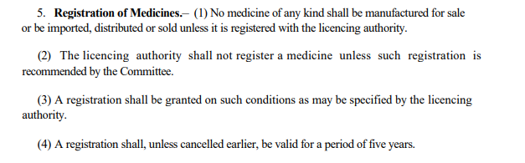
Answer 02
Please explain how in the context of Bangladesh registration of pharmaceutical products is connected to supply chain.
According to Directorate General of Drug Administration (DGDA) “No medicine of any kind shall be manufactured for sale or be imported, distributed or sold unless it is registered with the license authority” (published in : Drugs (Control) Ordinance (VIII), 1982).

Slide 16
Answer 03
What makes the pharmaceutical industry and the supply chain there stand out among plenty of other countries that produce primarily generic medications?
Export market is increasing. More than in 100 countries, Bangladeshi generic medicines are exporting.
3 to 4 times cheaper labor cost in the world also China & India.
Leading companies have major approvals (US FDA, EU GMP, UK MHRA, TGA Australia, ANVISA Brazil etc.)
Market size was around $2 billion in the year of 2015 and expected to increase $6 billion by 2025.
Notes:
FDA= Food and Drugs Administration
GMP= Good manufacturing practice
MHRA= Medicines and Healthcare products Regulatory Agency
TGA= Therapeutic Goods Administration
ANVISA= Brazilian Health Regulatory Agency

